Slide 1
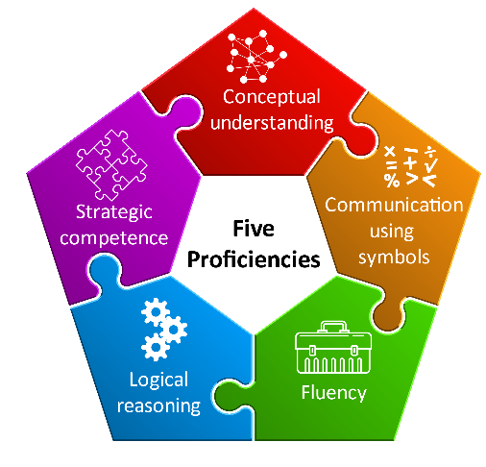
In the Mathematics and Numeracy AoLE we have specific principles of progression, based on the development of five interdependent proficiencies.
Understanding of concepts and ideas and explaining how they connect and relate across the Area
Understanding and using the conventions of symbols to communicate meaning
Building a range of strategies to solve and pose problems
Facts, techniques and relationships are firmly established so that they are usable and memorable
Understanding relationships between and within concepts to be able to justify and give proof
Notes:
Some people find it useful to explain each proficiency in a few words. You may find it helpful to create your own summary with your cluster to help you in developing your shared understanding of progression.
Conceptual understanding might be summarised as learners knowing and understanding why the maths works so that they are able to explain, connect and apply their thinking across the Area and indeed across the curriculum and in their everyday lives. As the image for conceptual understanding shows, learning builds and connects and mathematics is seen as one integrated whole. More simply put … YOU KNOW WHY YOU GOT THE ANSWER YOU GOT - YOU DON’T NEED TO MEMORISE OR RELY ON A FORMULA.
Strategic competence can be described as learners making progress in developing a wider range of strategies to be able to formulate and solve problems.
Progress in Logical reasoning means that learners can justify and prove their solutions to the problems they have solved. Reasoning is what doing maths is all about. And when we give learners time to reason, they will develop a positive disposition towards mathematics.
Fluency is about being able to recall, from memory with flexibility, three things - facts, techniques and relationships so that they can be used and applied whenever they are needed.
And Communication using symbols – well mathematics uses a symbol system and we need to teach this - learners will progress in the way they communicate using an increasing range of symbols and as they understand the conventions of the symbols they are using.

Slide 2
Communicating using symbols
Understanding that symbols
are abstract representations
choose and use notation and an increasing range of symbols correctly
express relationships concisely, in forms that are universally understood
Include appropriate units of measurement
2
9
˚C
π
+
÷
=
x
-
ml
g

Slide 3
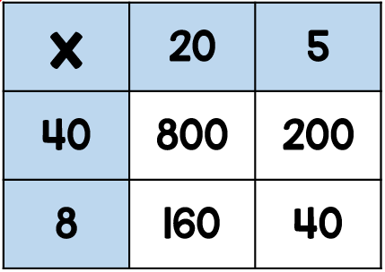
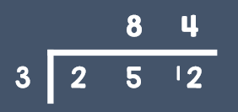
Fluency
Fluency is the recall and use of
facts, relationships and methods.
recall facts, relationships and methods
know how and when it’s appropriate to use them flexibly, efficiently and accurately
number bonds
times tables
Properties of shape
converting units
Full turn = 360˚
formulae
add 9 → +10,-1
divide 20 → ÷10, ÷2
½ = 0.5 = 50%
inverse
flexibly
efficiently
accurately

Slide 4
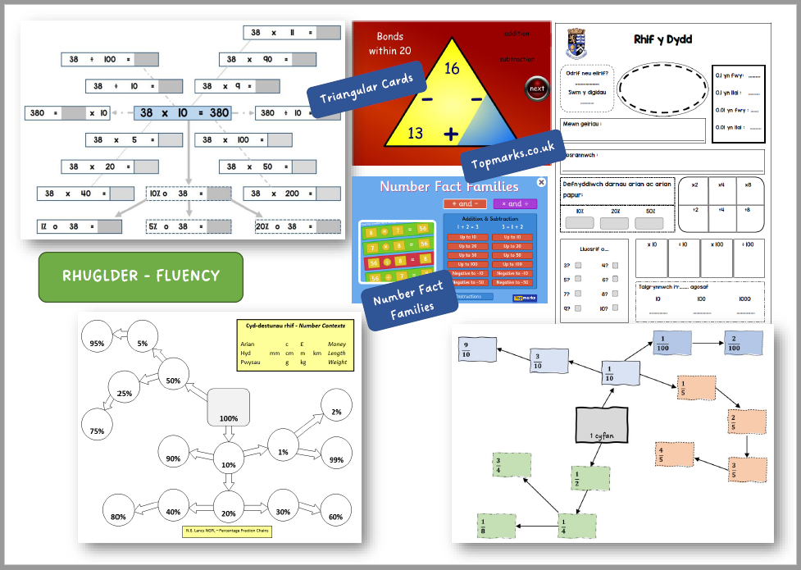

Slide 5
Strategic competence
Identify and carry out what is
required to solve a problem
identify what’s required to solve a problem
e.g. operation (+, -, x, ÷), the series of steps and methods
apply the mathematics required to solve the problem

Slide 6
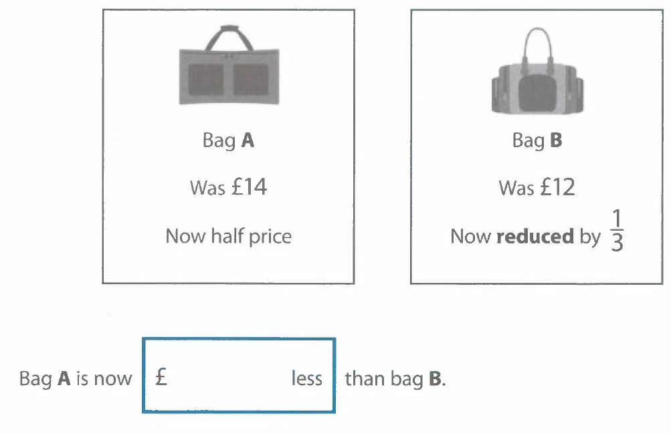
Problems in context and real life situations

Slide 7
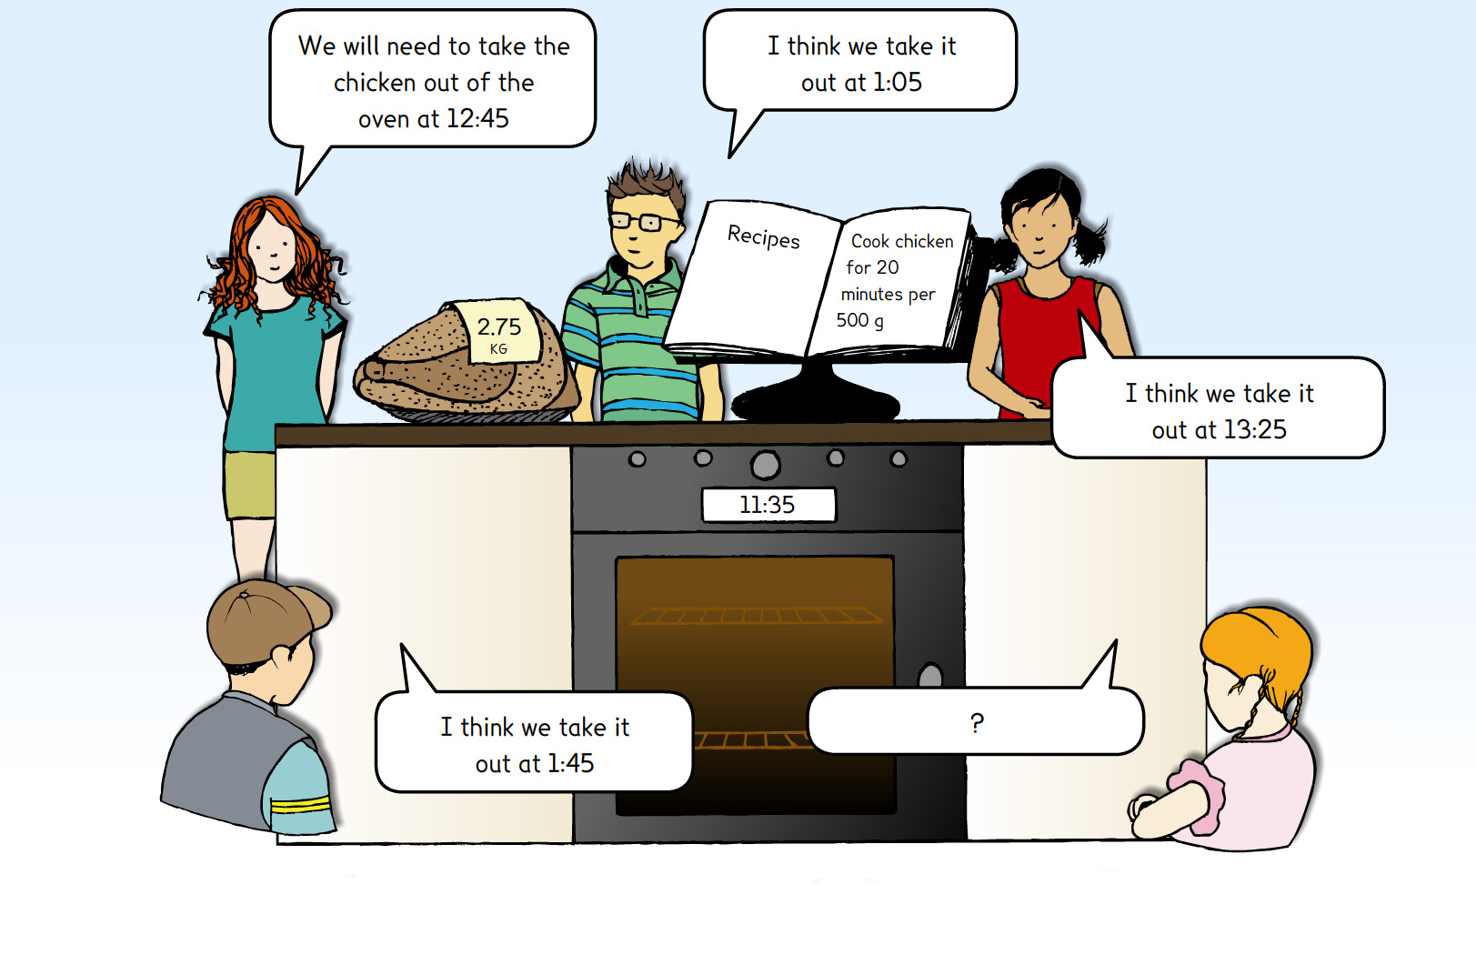

Slide 8
Logical reasoning
Explain, justify, prove and check
explain ideas and decisions
justify and proving by giving reasons, convincing or showing others
checking results or solutions

Slide 9
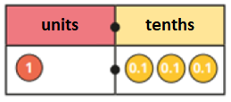
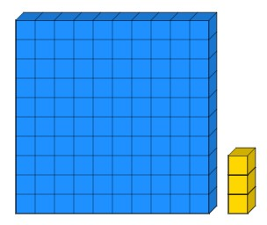
Which ones do not represent 1.3?
1.3
thirteen
1 $\frac{3}{10}$

Slide 10
Bob tro, weithiau, byth?
Always, sometimes, never
Wrth gyfri fesul 4, rydych yn glanio ar luosrifau o ddeg.
When counting in 4s, you land on multiples of ten.
Mae rhif 2-ddigid + rhif 2-ddigid yn rhoi ateb sy’n rif 3-digid
A 2-digit number + 2-digit number gives an answer which is a 3-digit number
Mae 5% o rif yr
un peth â $\frac{1}{5}$ o rif
5% of a number is the same
as $\frac{1}{5}$ of a number

Slide 11
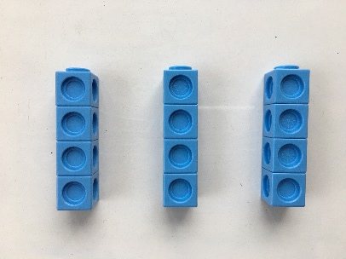
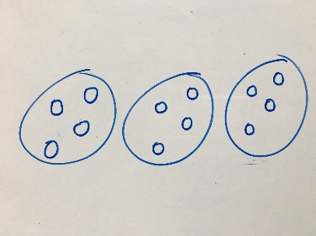
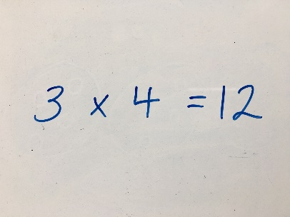
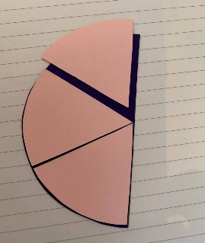
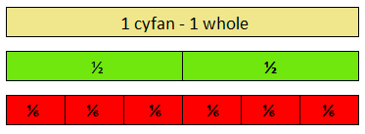
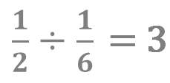
Conceptual understanding
Deepen and extend understanding of
mathematical concepts and connections
explain mathematical concepts e.g. in words, using a diagram / resources / examples or non-examples
represent a concept in different ways
i.e. concrete / pictorial / abstract, e.g. 3 x 4 = 12
make connections to other concepts / ideas within mathematics
transfer and use concepts in new contexts

Slide 12
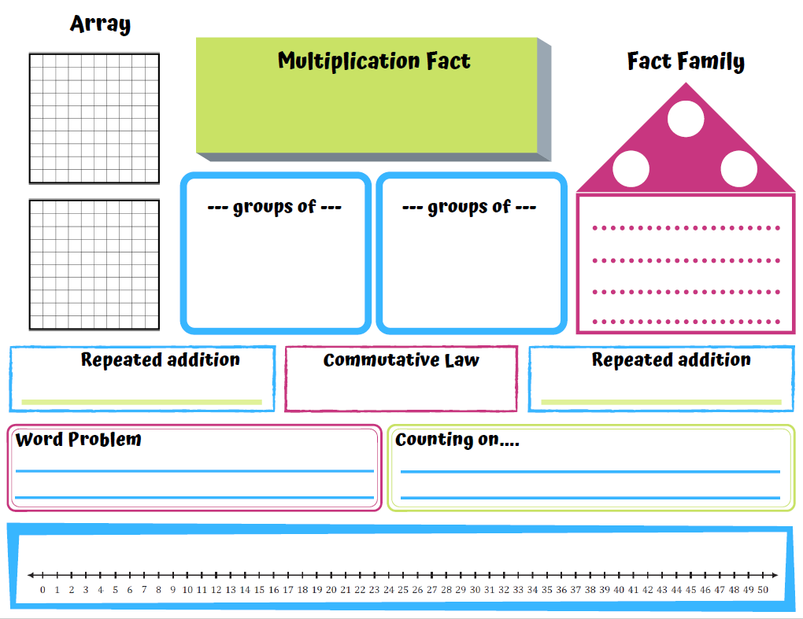
6 x 3
18
6
3
6
3
3
6
3 x 6 = 18
6 x 3 = 18
18 ÷ 6 = 3
18 ÷ 3 = 6
3 + 3 + 3 + 3 + 3 + 3
3 x 6
6 + 6 + 6
Megan compares the height of two trees.
One measures 6m and the other three times taller. What is the height of the second tree?
3, 6, 9, 12, 15, 18
6, 12, 18

Slide 13
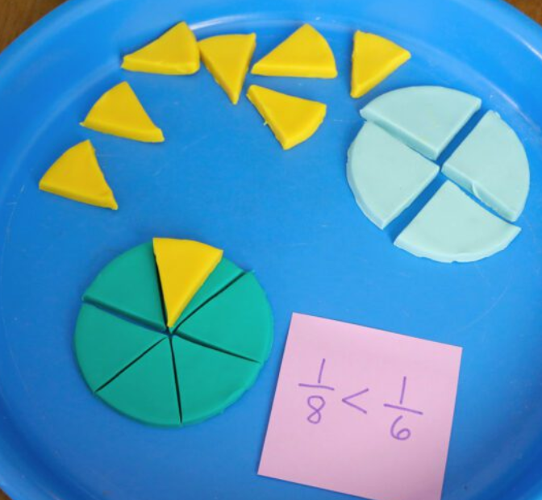
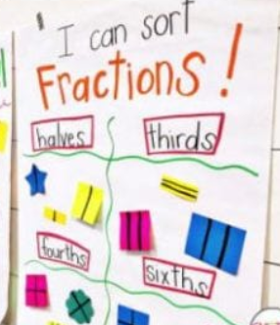
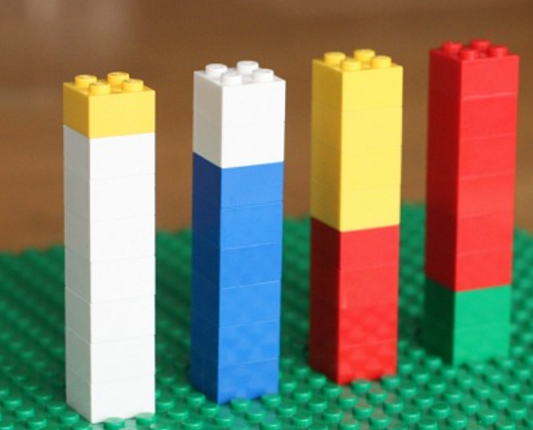
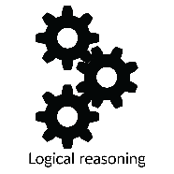
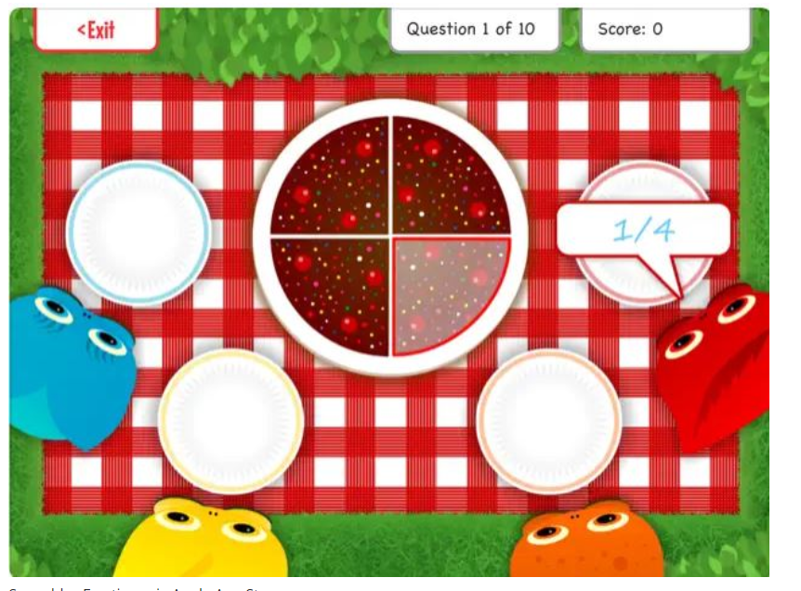
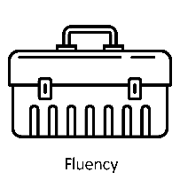
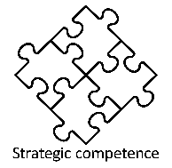
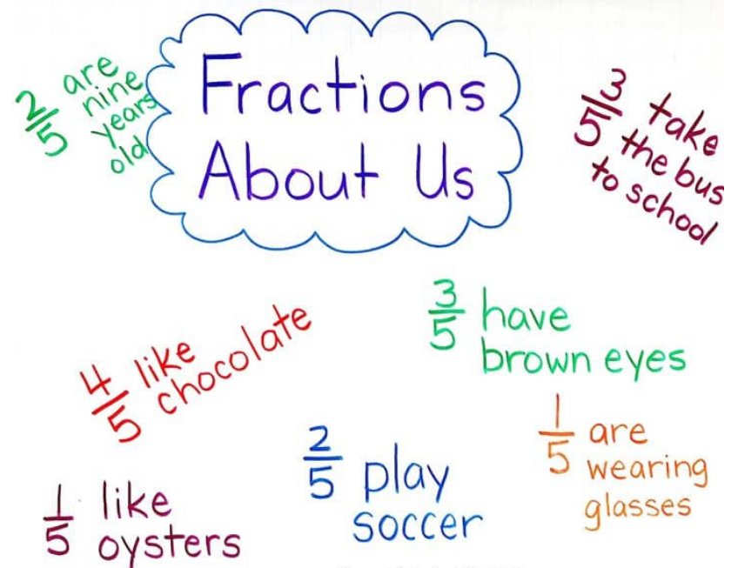
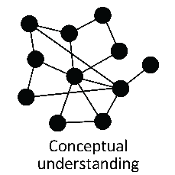
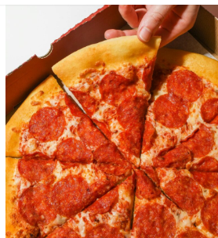
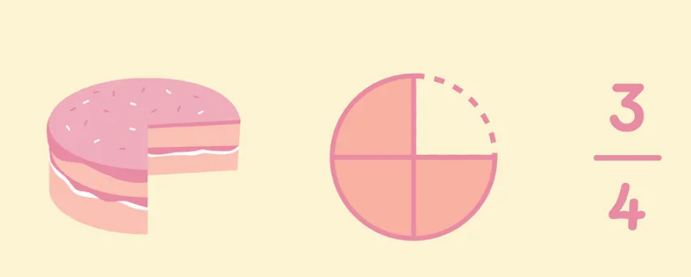
Topic Planning through the 5 proficiencies
White Rose Year 3
Fractions A and B
Representing fractions
https://www.weareteachers.com/make-teaching-fractions-easier/
Finding fractions of an amount
Comparing fractions
Fractions of amounts
Vinculum as a divisor
Within a real life context, time, scale, environment
¼ = 1 ÷ 4

Slide 14
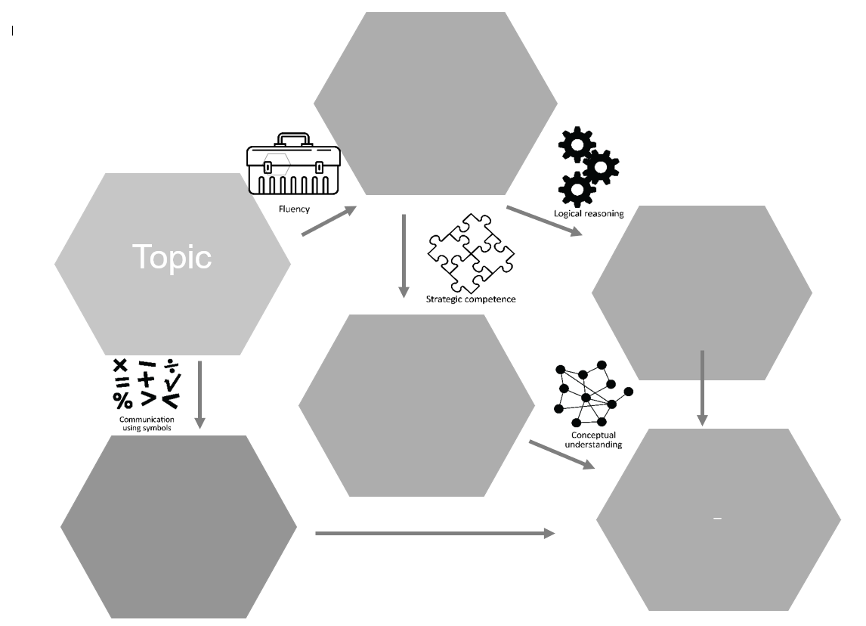

Slide 15
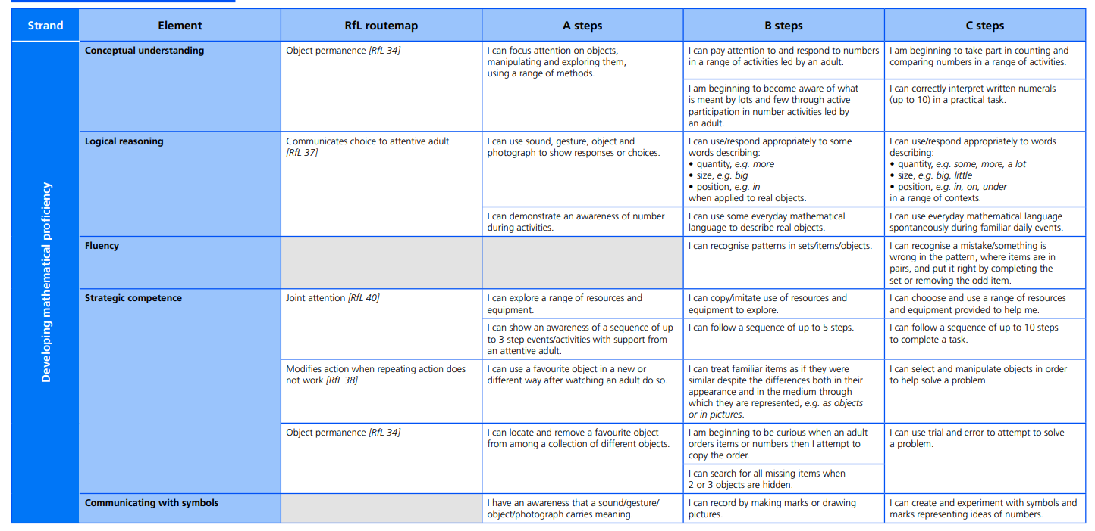

Slide 16
Exercise 1
1).
2).
3).

Slide 17
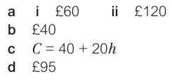
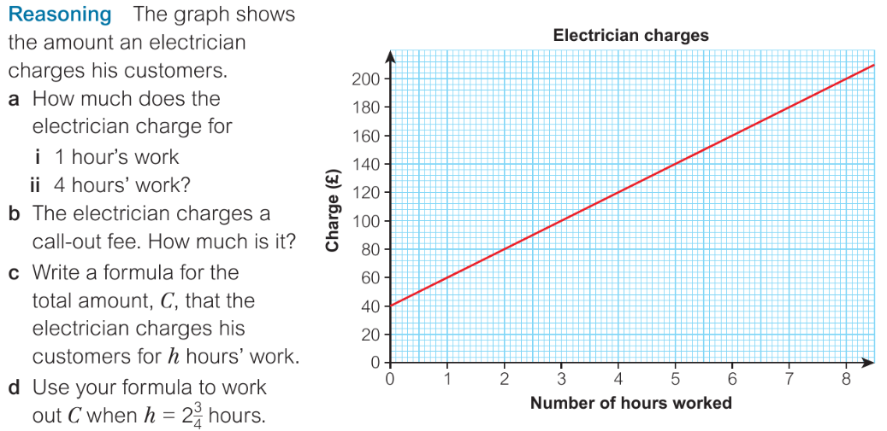
Exercise 2

Slide 18
Exercise 3
The school council are planning an end of year party and have narrowed down the choices to two venues.
For each venue write a formula for the total cost $C$ to host a party for $x$ people
Considering the cost and justifying your answer with data which venue do you think the school council should select?
(c) If you consider all factors, and not just the cost, then does your venue choice change? Why/Why not? What else would you like to know?
(d) Draw an appropriate graph to display both formulae.
Foyles of Glasbury
£100 room hire
£5 per person for refreshments
Castle Hotel - Brecon
£150 room hire
£3 per person for refreshments
$$C=100+5x$$
$$C=150+3x$$
For fewer than 25 attendees Foyles is cheaper, for more than 25 attendees The Castle is cheaper. There will likely be more than 25 attendees.
e.g. Which is the more convenient location, which has the best refreshments and facilities.

Slide 19
Doug Lemov – Cynllunio ar gyfer cwestiynu Planning for stretch it questioning
Mae Lemov yn awgrymu:
Gofynnwch Sut neu Pam
Gofynnwch am ffordd arall i ateb
Gofynnwch am air gwell
Gofynnwch am dystiolaeth
Gofynnwch i’r myfyriwr integreiddio sgil cysylltiedig neu Wybodaeth Ychwanegol
Lemov suggests:
Ask How or Why
Ask for another way to answer
Ask for a better word
Ask for evidence
Ask student to integrate a related skill or Addition Knowledge

Slide 20
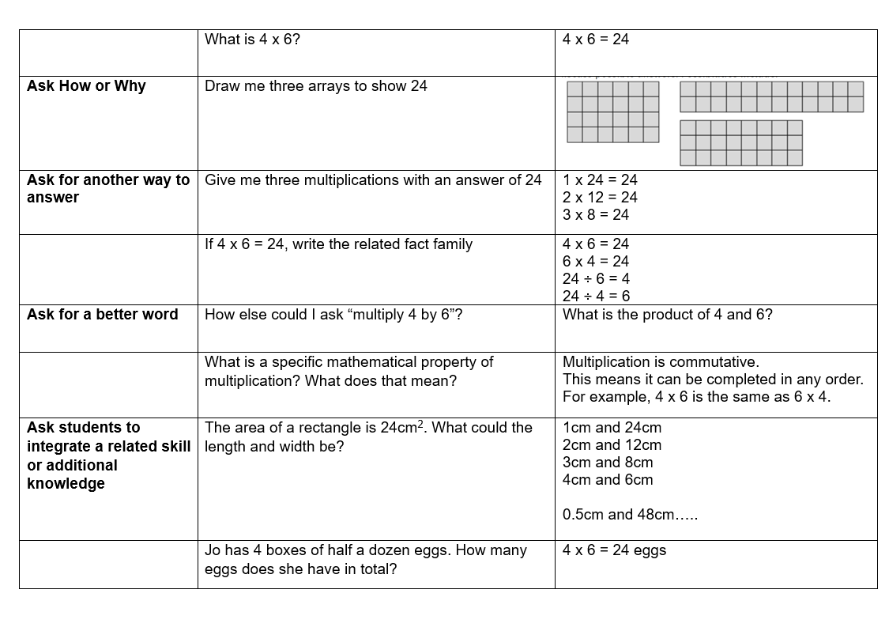
Enghraifft o sut i gynllunio Cwestiynu / Questioning planning exemplar

