Slide 1
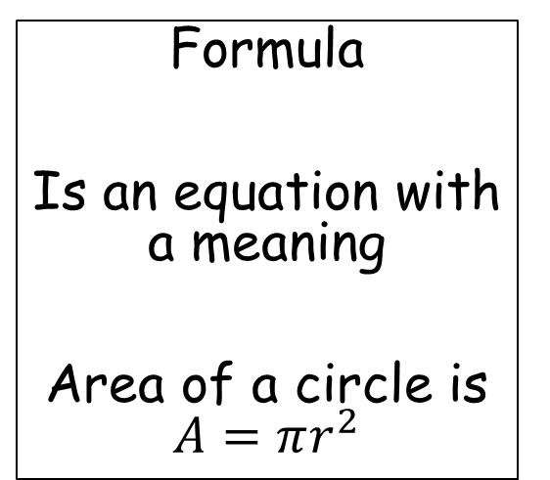
Term
X is a Term
2Y is a Term
Operator
+, -, x, ÷
Are all operators
Subject
x + 3 = y
Y is the subject
Expression
Has NO = sign
3a + 2
You cannot find a value for the letter if no = sign, these are often form or simplify questions.
Equation
Has an = sign
2q + 3 = 23
You can find a value for the letter.
Formula
Is an equation with a meaning
Area of a circle is $A=πr^{2}$

Slide 2
Solve
3x + 2 = 14
What number is x?
Form
There are 3 apples and 2 bananas form an expression
3a +2b
Simplify
(Collect Like Term)
3a + 2b –a + 3b
Terms can be collected to simplify to this
2a + 5b
Expand
2(3x + 4)
Expand the brackets by multiplying them out.
6x + 8
Factorise
4x + 8
Put the brackets back in, opposite of expanding.
4(x + 2)
Calculate
Same as solving
Find the value of the letter in the question.

Slide 3
Find
Same as solving
Find the value of the letter in the question.
Make ‘x’ the Subject
Make b the subject
2a + b = c
C is the current subject
b = c – 2a
In terms of
Similar to make ‘x’ the subject and Changing the subject
Integer
Is a whole number
3 and 7 are integers 2.2 is not it is a decimal.
Brackets in algebra
Means to multiply
So 2(a + 3)
means
2 x a and 2 x 3

Slide 4
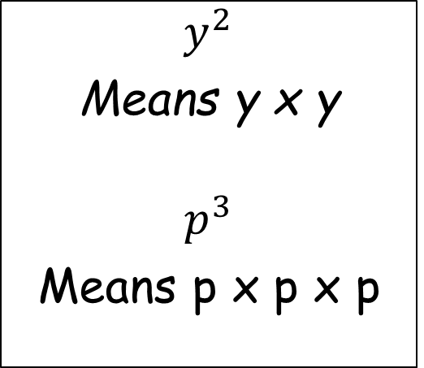
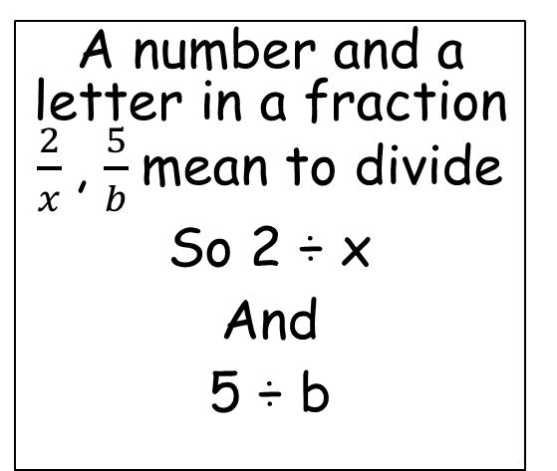
A number by
a letter 2q, 3y, means to multiply
So 2 x q
and
3 x y
A number and a letter in a fraction $\frac{2}{x}$, $\frac{5}{b}$mean to divide
So 2 ÷ x
And
5 ÷ b
$y^{2}$
Means y x y
$$p^{3}$$
Means p x p x p

Slide 5
Solve Algebraically
Solve using formula and letters
EG Area of a square
Is Base (b) x Height (h)
A = b x h
A=bh
Inequality
These are inequality signs
< ≤ > ≥
Inequality questions are asking to find what possible numbers could fit between two other numbers
Eg 3x-5 < 19
The answer could be any number greater than 8
Trail and Improvement
x³ + 2x = 42
has a solution between 3 and 4.
You have to test the number 3 and the number 4 as a replacement for x.
One will be too big and one will be too small you then try 3.5, then 3.6, then 3.7 and so on until you get an answer close to 42.

